Slide 1
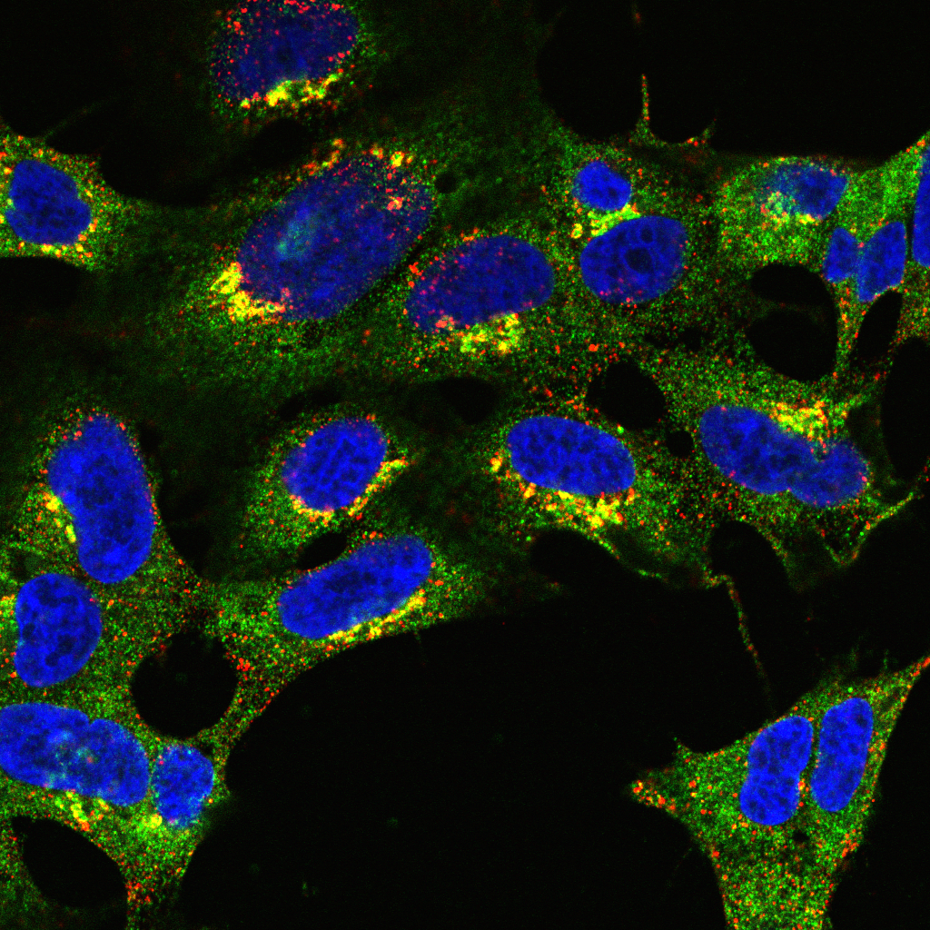
Introduction to colocalisation analysis Part 3

Slide 2
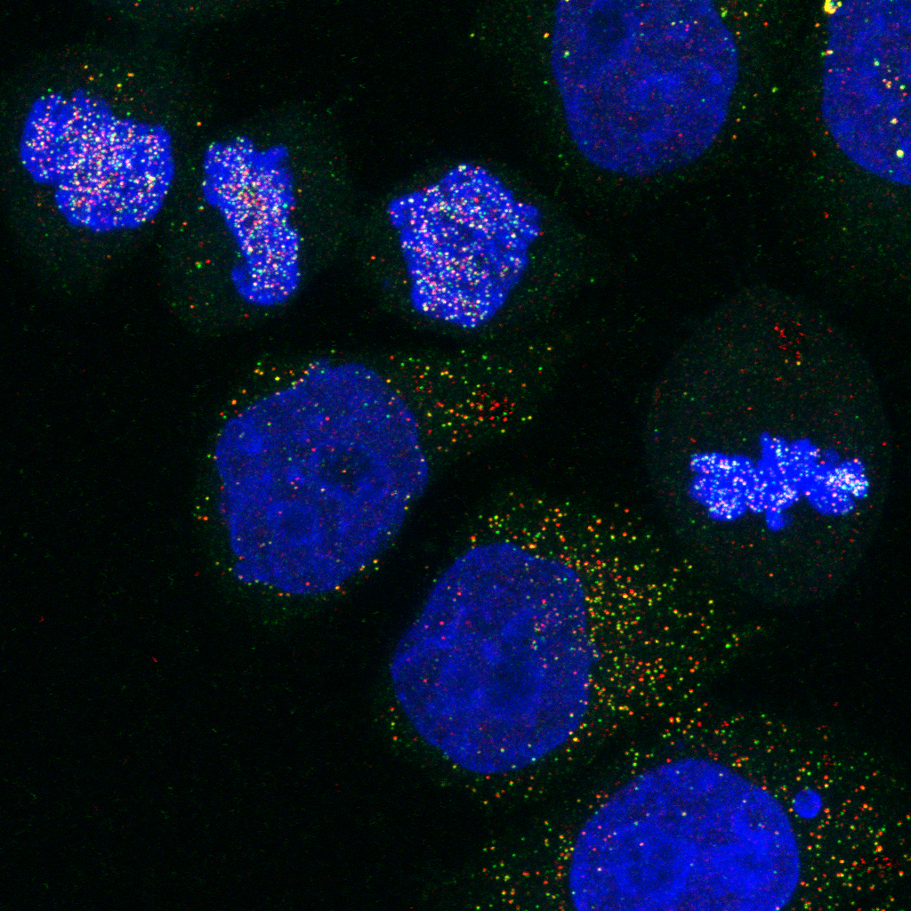
Co-occurance Based approaches

Slide 3
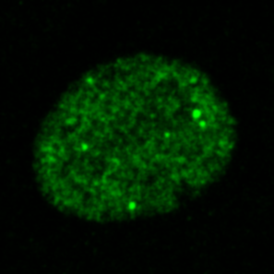
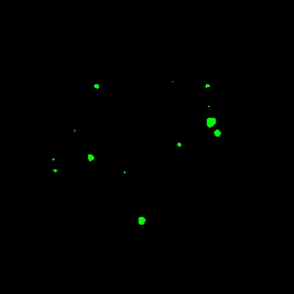
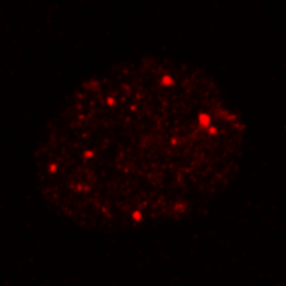
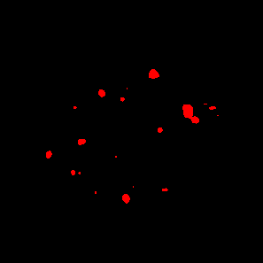
Object-based correlation coefficients
Detect objects:
Thresholding
Local maxima detection
Relate objects:
% Overlap
But with high resolution, probes may not overlap!
Nearest Neighbour
Mean Distance to Other objects
Cluster analysis

Slide 4
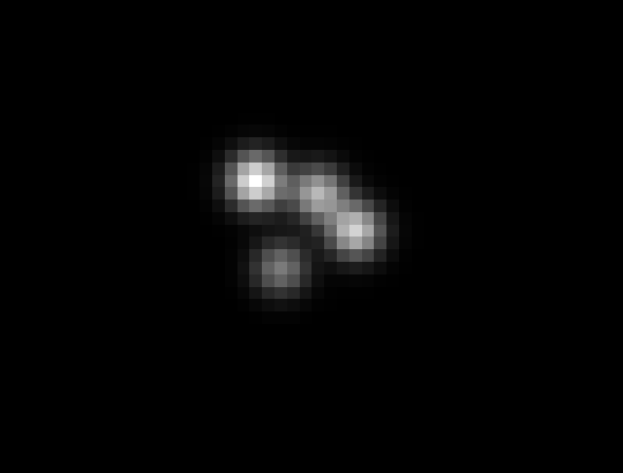
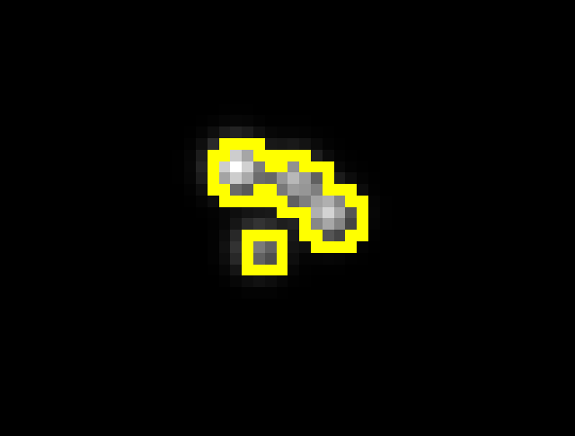
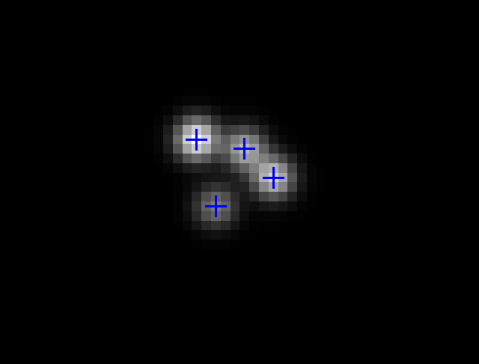
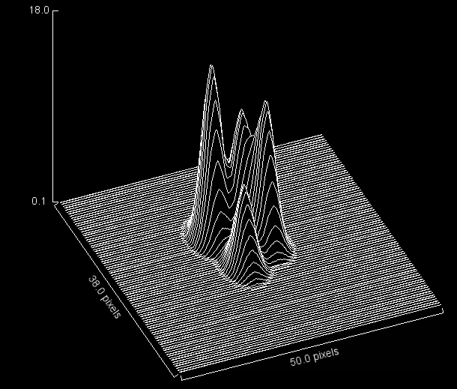

Slide 5
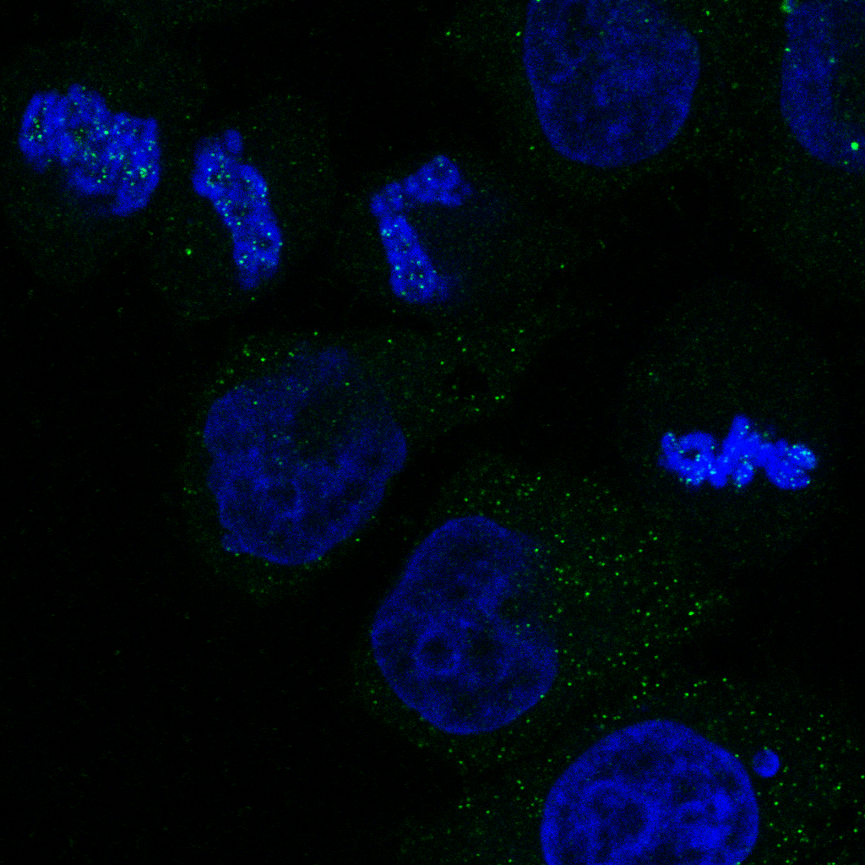

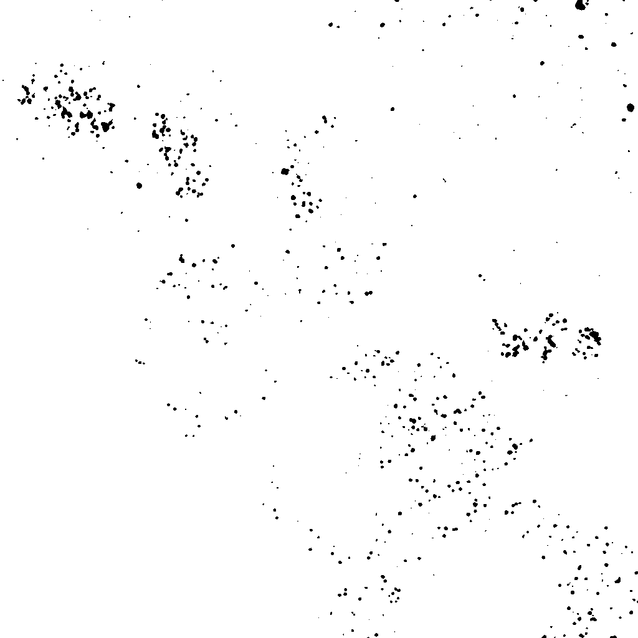
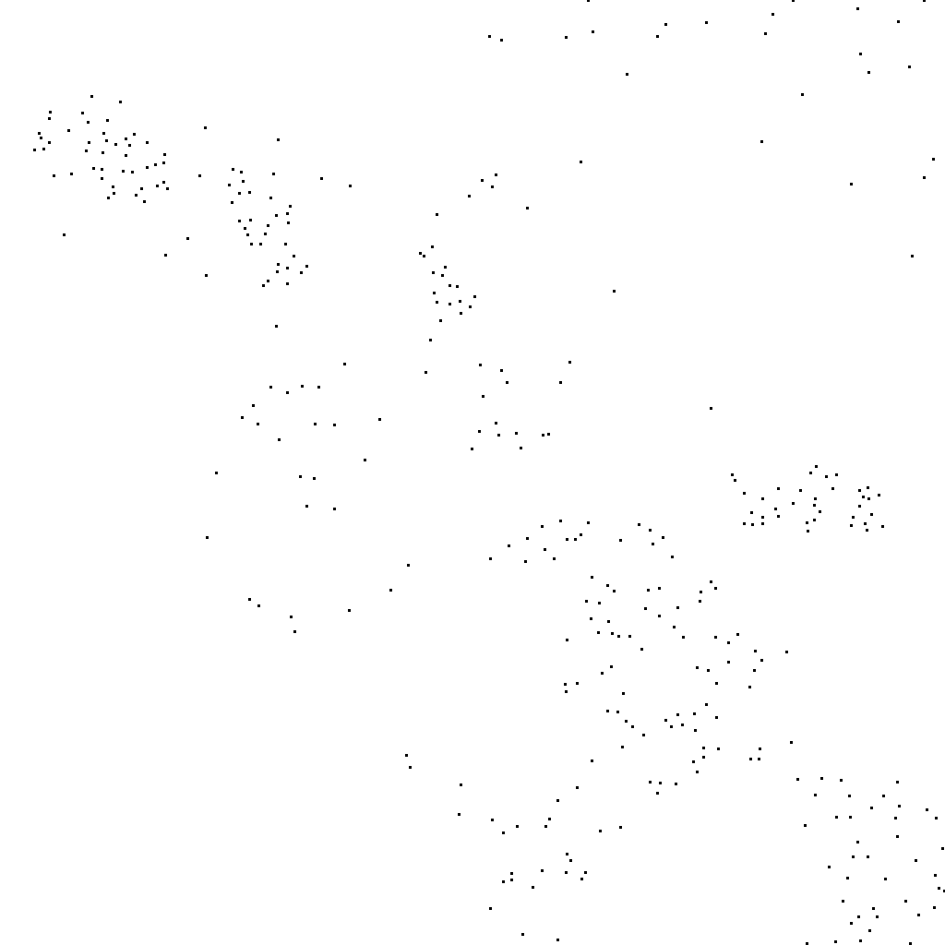
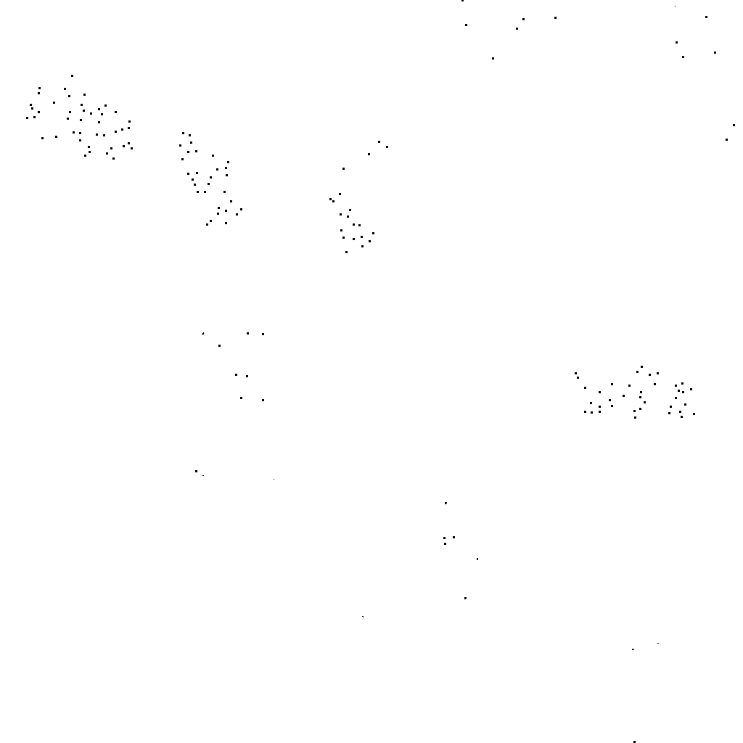

Relating different objects
Thresholded Dots
Find Maxima Dots
Nuclear Dots
Non-Nuclear Dots

Slide 6

A more refined approach relates distances…
Euclidean geometry – computationally intensive:
(x₁, y₁)
d
(x₂, y₂)
$$d= \sqrt{{\left(x_{2}−x_{1}\right)}^{2}+{(y_{2}−y_{1})}^{2}}$$
Counting pixels – limited resolution, but fast:
(x₁, y₁)
1
2
3
(x₂, y₂)

Slide 7
Distance Maps
1 | 1 | 1 | 1 | 1 | 1 | 1 | 1 | 1 | 1
1 | 0 | 1 | 0 | 0 | 1 | 1 | 1 | 0 | 1
1 | 1 | 0 | 0 | 0 | 1 | 0 | 0 | 0 | 1
1 | 0 | 0 | 0 | 0 | 0 | 0 | 0 | 0 | 1
1 | 0 | 0 | 0 | 0 | 0 | 0 | 0 | 0 | 1
1 | 1 | 0 | 0 | 0 | 0 | 0 | 0 | 1 | 1
1 | 0 | 0 | 0 | 0 | 0 | 0 | 0 | 1 | 1
1 | 0 | 0 | 0 | 0 | 0 | 0 | 0 | 1 | 1
1 | 0 | 1 | 1 | 1 | 0 | 0 | 0 | 1 | 1
1 | 1 | 1 | 1 | 1 | 1 | 1 | 1 | 1 | 1
0 | 0 | 0 | 0 | 0 | 0 | 0 | 0 | 0 | 0
0 | 1 | 0 | 1 | 1 | 0 | 0 | 0 | 1 | 0
0 | 0 | 1 | 1 | 1 | 0 | 1 | 1 | 1 | 0
0 | 1 | 1 | 2 | 1 | 1 | 1 | 2 | 1 | 0
0 | 1 | 1 | 2 | 2 | 2 | 2 | 1 | 1 | 0
0 | 0 | 1 | 2 | 3 | 3 | 2 | 1 | 0 | 0
0 | 1 | 1 | 2 | 2 | 2 | 2 | 1 | 0 | 0
0 | 1 | 1 | 1 | 1 | 1 | 2 | 1 | 0 | 0
0 | 1 | 0 | 0 | 0 | 1 | 1 | 1 | 0 | 0
0 | 0 | 0 | 0 | 0 | 0 | 0 | 0 | 0 | 0

Slide 8
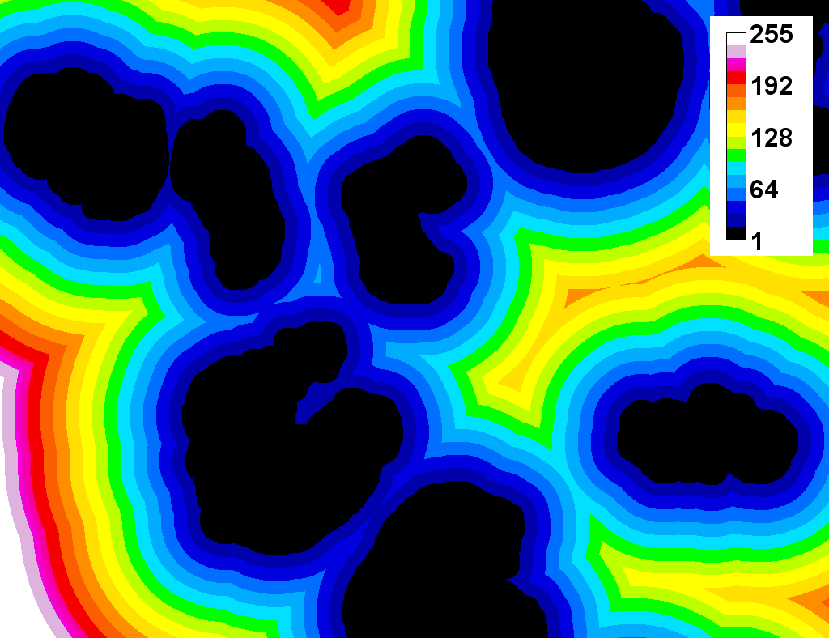
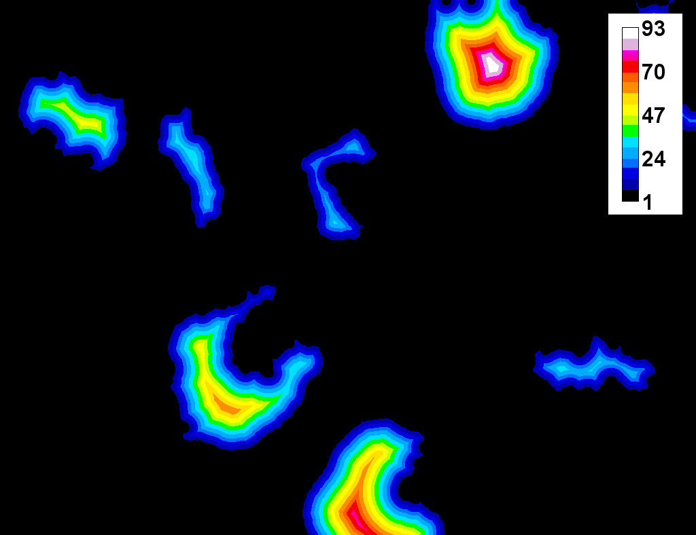
Using maps to plot distances

Slide 9
Demo 7: Calculate relative nuclear expression

Slide 10
Challenge 1: nuclear localisation
Open the images in the Challenge 1 folder with Bio-Formats:
Measure the mean distance of dots in channel 1 to the nuclei in channel 2
Generate a distance map based on the nuclear channel
Detect the dots in channel 1
Use the Particle Analyzer to measure the distance of each dot from the nuclei

Slide 11
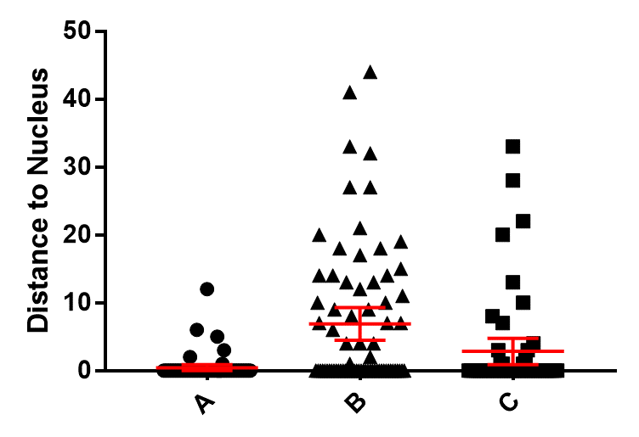

Slide 12
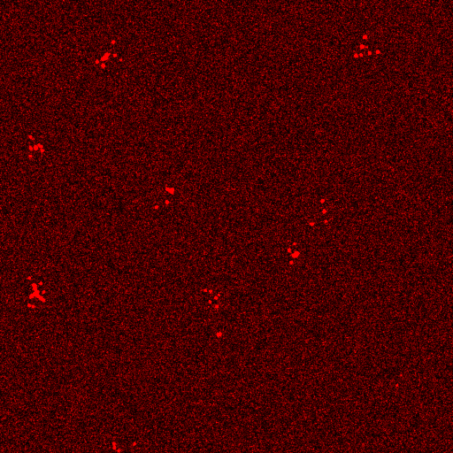
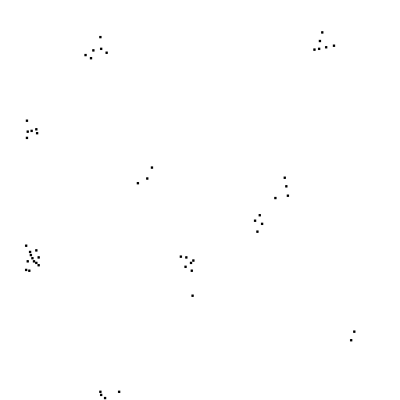
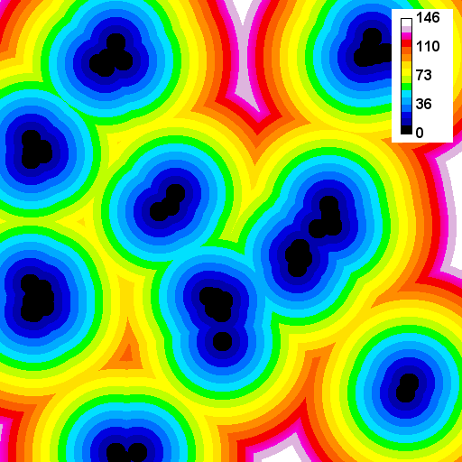
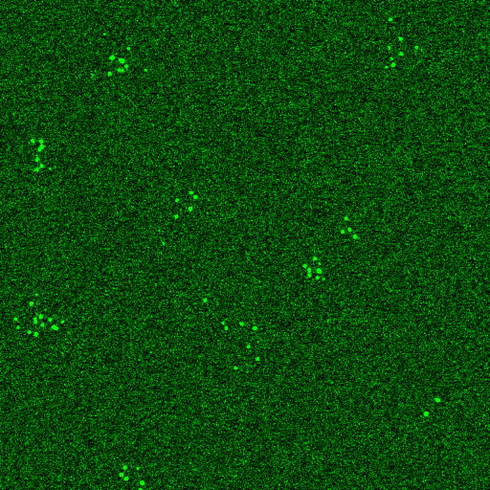
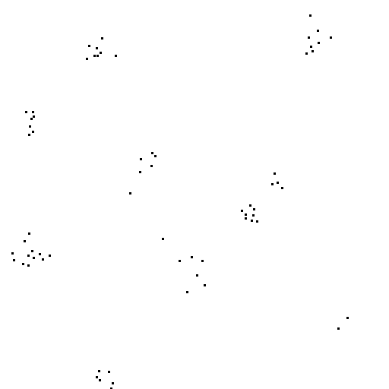
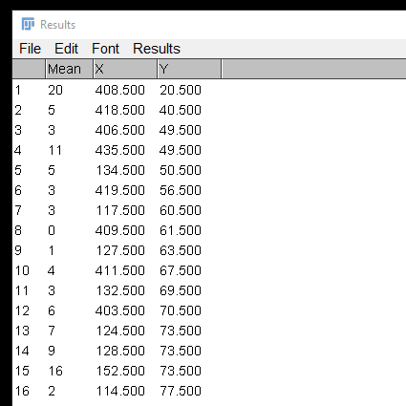

Slide 13
Demo 8: distance maps to measure localisation

Slide 14
Challenge 2: colocalization of dots
Open the images in the Challenge 2 folder with Bio-Formats:
Measure the mean distance of dots in channel 1 to the dots in channel 2
Generate a distance map based on the dots in channel 1
Detect the dots in channel 2
Use the Particle Analyzer to measure the distance of each dot in one channel from the other

Slide 15
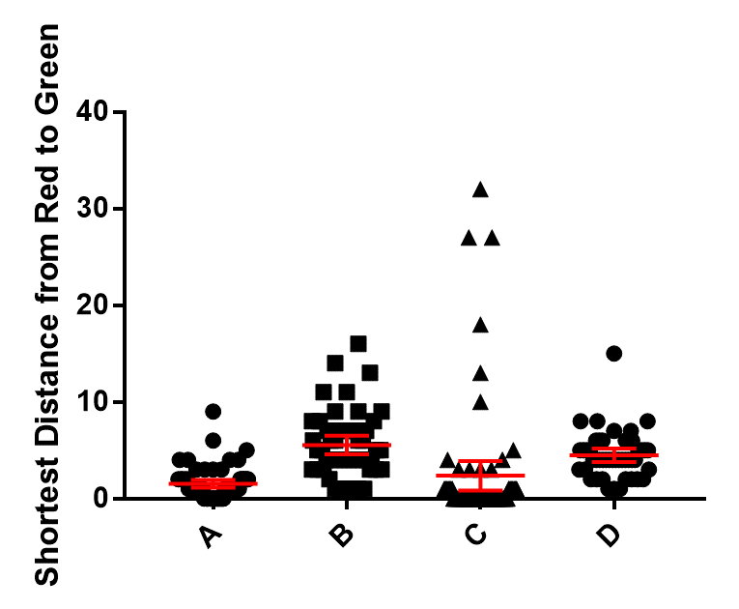

Slide 16
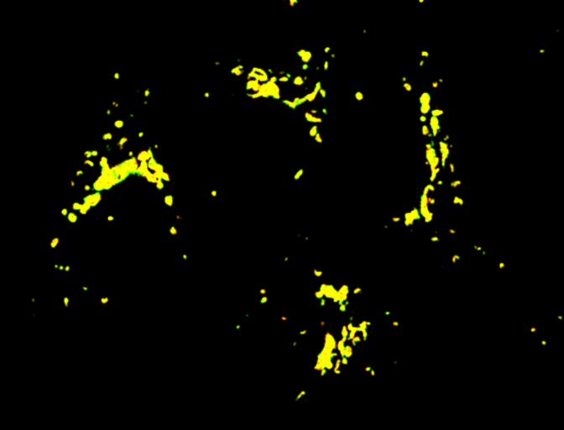
“Colocalisation” means different things to different people
Red + Green = Yellow?
Co-occurrence:
Molecules present in a region
No concentration relationship
Correlation analysis:
Stoichiometric relationship between molecules
No spatial information
A
B

Slide 17




Slide 18
The Importance of controls

Slide 19
Controls
Correlation coefficients mean little in isolation
Analyses should include positive and negative controls
But, control samples may not exist
Practical alternative: generate a “random” distribution by scrambling, translation or rotation.

Slide 20
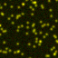
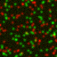
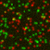
Generating controls
Original
Rotated 90°
Randomised
P = 0.95
P = -0.06
P = 0.00

Slide 21
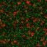
Things to consider when generating controls
Original
Random Noise
P = 0.95
P = 0.00
Spatial Autocorrelation: the value of one pixel is likely to be similar to that of its neighboring pixels.
Most indicate a block size should be the size of the PSF
Should equal or exceed the size of the objects in an image

